Slide 1


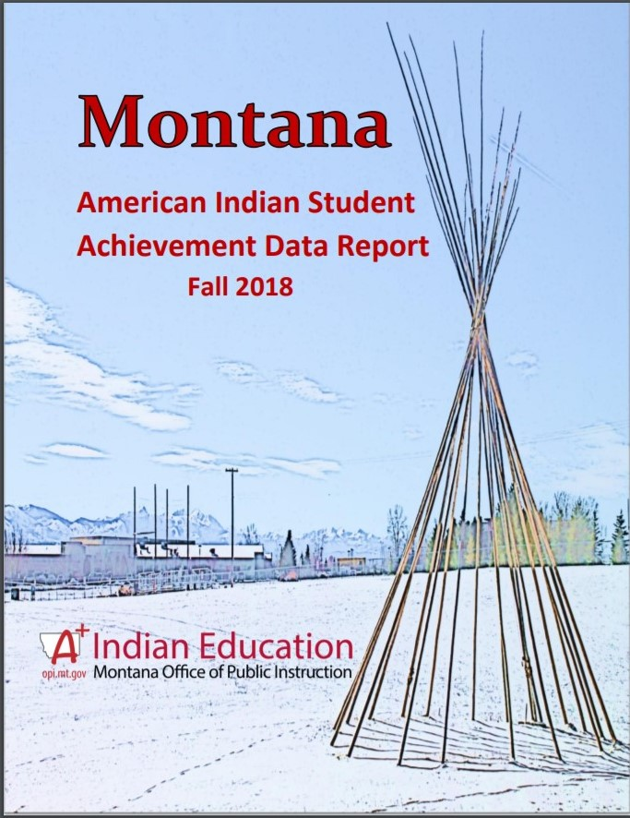

Montana Advisory Council on Indian Education (MACIE)
Overview: Mission & Vision
March 11, 2021
The American Indian Student Achievement Data Report is Compiled and Drafted by the Office of Public Instruction and Provided to the State Legislature on the Years they are in Session
Office of Public Instruction
American Indian Student Achievement Unit

Slide 2

MACIE Constitution – Mission
(Approved May 8, 2019)
MISSION
The Montana Advisory Council on Indian Education was established by the Board of Public Education and the Office of Public Instruction to function in an advisory capacity for the education of American Indian students in Montana (MACIE represents ALL American Indian Students from ALL school districts & systems of education, across the State of Montana). The Montana Advisory Council on Indian Education shall be a strong voice for collaborative efforts among tribal, state (Montana Office of Public Instruction (OPI) and Montana Board of Public Education), and federal organizations, institutions, groups, and agencies for the express purpose of promoting high quality and equitable educational opportunities for all American Indian students in Montana (American Indian Student Achievement Gap). This includes, but is not limited to, culture, language, and Indian Education for All.

Slide 3
MACIE – Purpose
The purpose of MACIE shall be:
Advise the Board of Public Education (BPE) and the Superintendent of Public Instruction (OPI) in matters affecting the education of American Indian students, including accreditation, certification, and teacher training;
Promote equal educational opportunities and improve the quality of education provided to American Indian students throughout the State of Montana;
Advise, monitor, evaluate, and advocate for the implementation of Indian Education for All as defined in Article X, section 1(2) of the Montana Constitution and MCA 20-1-501 for all educational agencies; and
Carry out the goals and responsibilities of MACIE, report to BPE and OPI, and complete an annual progress review.

Slide 4
MACIE Members
Voting Members
MACIE will be comprised of 17 voting members consisting of:
  8 representatives from each Montana tribe
  3 representatives from urban school district Indian Education Departments
  1 representative from Montana Federation of Public Employees (MFPE)
  1 representative from School Administrators of Montana (SAM)
  1 representative from Indian Impact Schools of Montana (IISM)
  1 representative from Montana School Boards Association (MTSBA) Indian School Board Caucus
  1 representative from Montana Indian Education Association
  1 representative from Class 7 teachers
MACIE shall be comprised of six ex-officio (non-voting) members consisting of:
  1 representative from Office of Public Instruction
  1 representative from Board of Public Education
  1 representative from Montana University System
  1 representative from Bureau of Indian Education Schools
  1 representative from Tribal Head Starts
  1 representative from Tribal Colleges

Slide 5
MACIE – Relationship to BPE
MACIE’s Relationship, Role, and Responsibility to:
Montana Board of Public Education (BPE)
Advise the Board of Public Education (BPE) in matters affecting the education of American Indian students, including accreditation, certification, and teacher training.
Report to BPE; complete an annual progress review.
Act as liaisons between OPI and BPE and member organizations
BPE and OPI jointly make appointments to MACIE
The chairperson or designee will represent and present reports for MACIE at all BPE meetings

Slide 6
MACIE – Relationship to OPI
MACIE’s Relationship, Role, and Responsibility to:
Montana Office of Public Instruction (OPI)
Advise the Montana Office of Public Instruction (OPI) in matters affecting the education of American Indian students, including accreditation, certification, and teacher training.
Report to OPI; complete an annual progress review.
Act as liaisons between OPI and BPE and member organizations
BPE and OPI jointly make appointments to MACIE
OPI ex-officio member (State Superintendent) shall assist MACIE in its efforts to achieve its goals.
The Montana Office of Public Instruction provides vision, advocacy, support and leadership for schools and communities to ensure that all students meet today's challenges and tomorrow's opportunities.

Slide 7
MACIE – Relationship to External Partners
MACIE’s Relationship, Role, and Responsibility to External Partners
Montana Office of the Commissioner of Higher Education (OCHE)
Tribal Education Departments
Tribal Colleges
American Indian Higher Education Consortium (AIHEC)
American Indian Minority Achievement Advisory Council (AIMA)
Montana Indian Education Association (MIEA)
Tribal Contract Schools (BIE)
Native Language and Immersion School Programs
Tribal Councils
MACIE Represents a Broad Coalition of Strategic External Partners & Constituencies

Slide 8
MACIE - Advisory Council Role in Monitoring Initiatives
In fulfilling its advisory responsibility and obligations to the BPE, OPI and external partners MACIE in its issue advocacy role, continually monitors the implementation and integration of the initiatives it has identified, elevated and supported through on-going communication and collaboration with its strategic partners.
When amplifying the voice of its constituency in tribal communities and school systems MACIE shares an on-going responsibility along with its strategic partners to promote, enrich and enhance awareness of collaborative efforts focused on improving educational equity, opportunity and American Indian student achievement.

Slide 9

MACIE - Aligning the Guiding Principles to the Goals
The Guiding Principles Inform and Support the Goals
GUIDING PRINCIPLES
(Mission)
Advise Promote Improve Monitor Evaluate Advocate Explore Provide
Goal 1
Goal 2
Goal 3
Goal 4

Slide 10
MACIE – Student Success Goal 1
Intent:
Improve community, family and parental engagement with local school systems
Student Success: Goal 1:
MACIE will advocate for and alongside communities, families, parents and school systems that serve NA/AI student populations with the intent of promoting efforts to ensure safe, secure, and stable educational environments where students and parents feel welcome and supported.

Slide 11
MACIE - Student Success Goal 2
Intent: Improve school programing targeting systemic racism, disparate discipline, student achievement, and historical (generational) trauma
Student Success: Goal 2
MACIE will encourage the adoption of school-based programing which addresses the presence of systemic racism, and the associated disparate discipline of NA/AI Students in public schools, with the intent of supporting efforts focused on exploring the impact that these conditions have upon student achievement

Slide 12
MACIE – Student Success Goal 3
Intent:
Expand access to culture, language, and culturally relevant curriculum
Student Success: Goal 3
MACIE will act as an advocate for the meaningful integration of culture, and indigenous language in Montana schools by promoting the adoption of culturally relevant curriculum, and instruction in support of the expression of NA/AI student self identity and self actualization.

Slide 13
MACIE – Student Success Goal 4
Intent:
Create opportunity for equitable access to virtual teaching-learning platforms and connectivity
Student Success: Goal 4
MACIE supports community programs that are focused on providing equitable access for NA/AI students to technological resources and internet connectivity within rural communities and school systems in response to the growing demand for the integration of virtual teaching and learning.

Slide 14
Advisory Council Structure– Guidance vs. Governance
Unlike Governing “Boards” the role of an Advisory “Council” is unique
The goal of an advisory council is to provide valuable assistance, advice, and expertise
Advisory Council members are hand-selected and recruited for the expertise that they can bring to an organization.
Advisory Council members help to fill in gaps of knowledge, experience and perspective.
Unlike the board of directors, an advisory council doesn't have formal legal responsibilities or decision-making authority and can't issue directives that must be followed.
An advisory council makes recommendations and provides information and materials to the problem solvers.

